Slide 1
Pushes and pulls
Year 7 Science

Slide 2
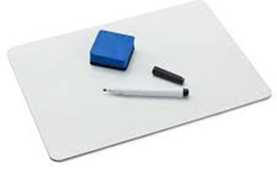
Lab Vocab
mass
kilogram
force
Newton
friction
gravity
weight
balance

Slide 3
Review
Convert to Newtons
100 kg
50 kg
0.2 kg

Slide 4
Learning Intentions
Change to an object’s motion is caused by unbalanced forces acting on the object.
investigating the effects of applying different forces to familiar objects

Slide 5
Success criteria
Use digital equipment to measure forces.
Compare pushes and pulls for different objects and surfaces.

Slide 6

Investigation: Is it easier to push or pull an object?

Slide 7
Investigation: Is it easier to push or pull an object?

Slide 8
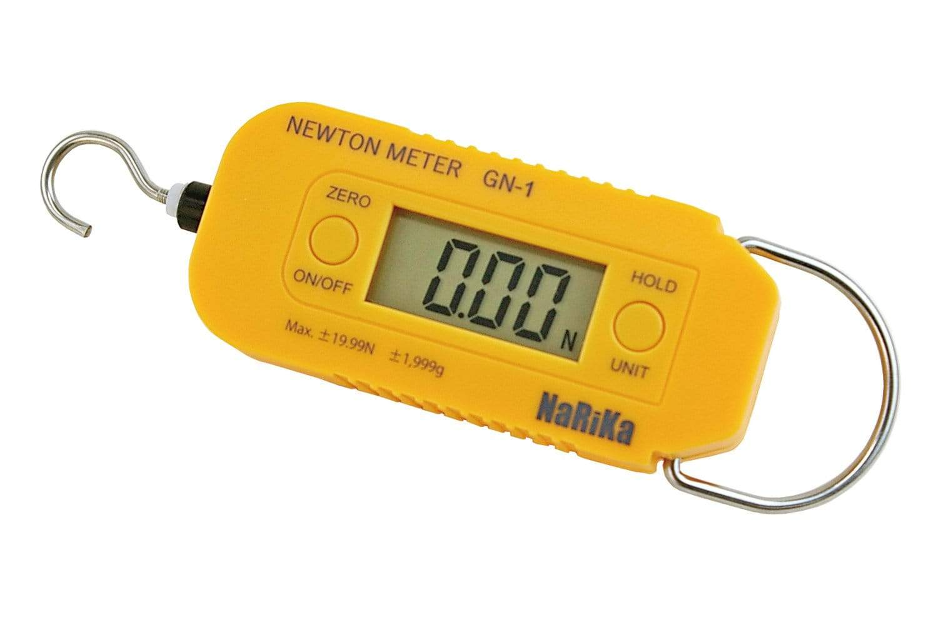
Investigation: Is it easier to push or pull an object?
How will you measure your results?
Repeat trials vs replicates
How will you record your results?
How will you present your results?

Slide 9
Success criteria
Use digital equipment to measure forces.
Compare pushes and pulls for different objects and surfaces.

